Slide 1
Lec: 18 - SFSS- SP – 03c
Causes of illiteracy

Slide 2
Causes of Illiteracy

Slide 3
Causes of Illiteracy
Governmental Level
School Level
Community Level

Slide 4
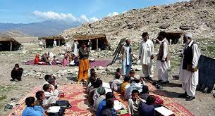
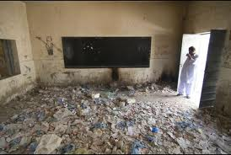
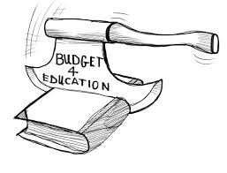
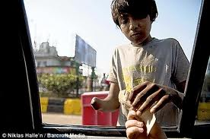
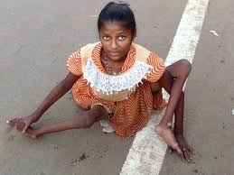
Gov: Level
Lack of school.
Lack of govt: supervision.
Lack of adult education centers.
No restriction for compulsory education.
No concept of free quality education
Lack of educational facilities for special people

Slide 5
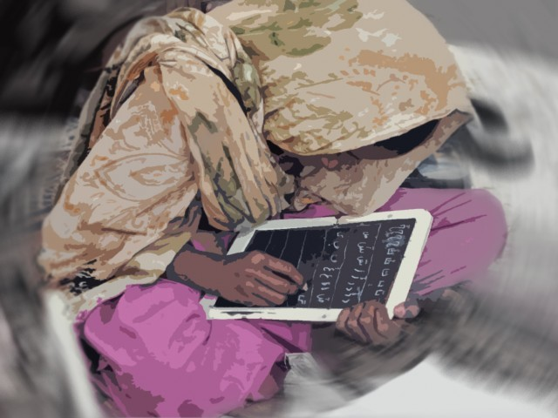
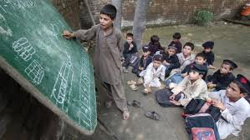
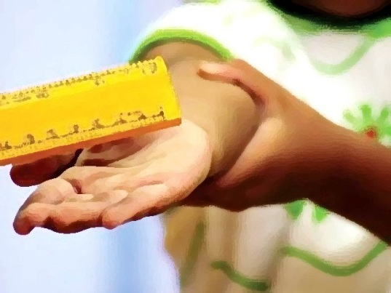
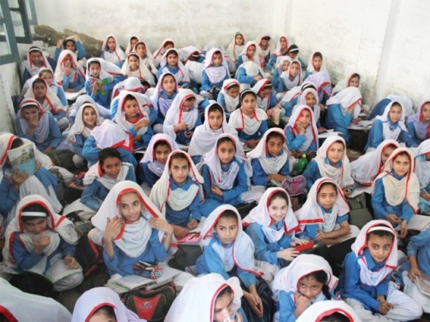
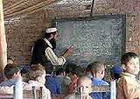
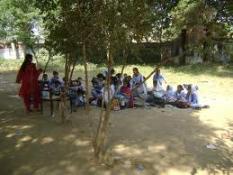
School Level
Heavy taxes on private institutions
Expensive education
Less salaries of teaching staff
Un-trained teachers
Lack of seminars and in-services training
No encouragement of student and teachers
Lack of attraction for the students
Lack of recreational facilities
Over crowdedness in the classes

Slide 6
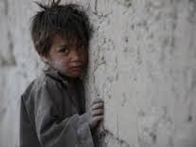
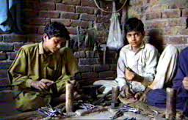
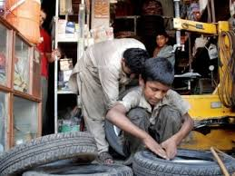
Community Level
Demand of separate schools
Poverty
Misperception regarding knowledge/education
No awareness about the importance of education.

Slide 7
